Slide 1
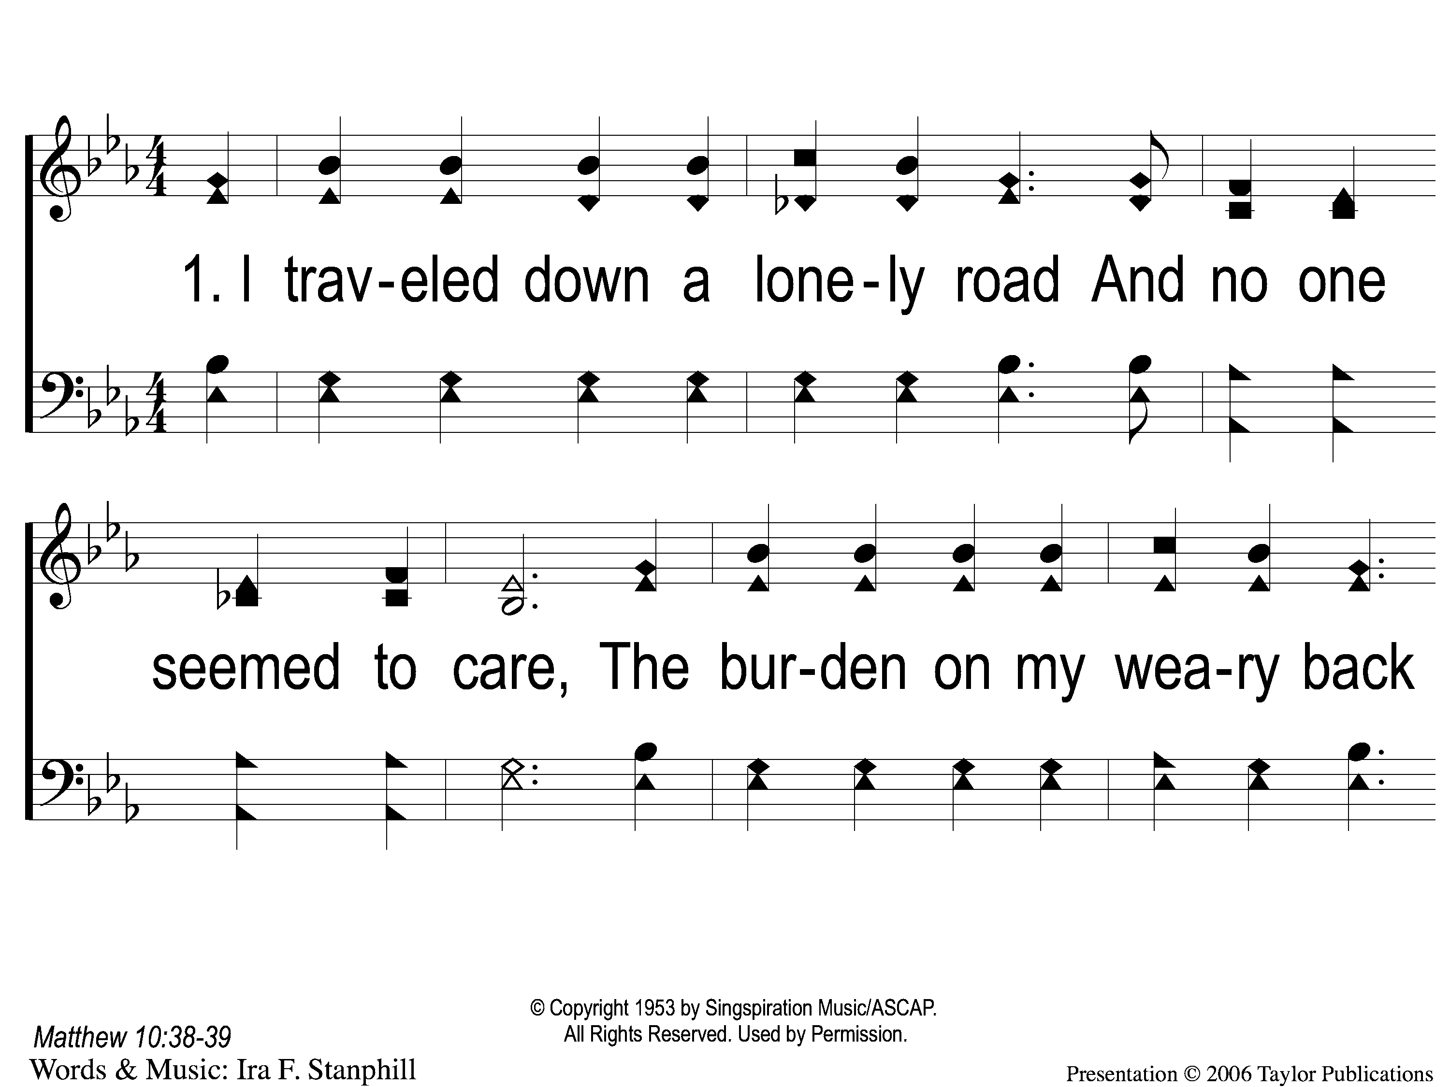
1-1 Follow Me
Follow Me
724
107

Slide 2
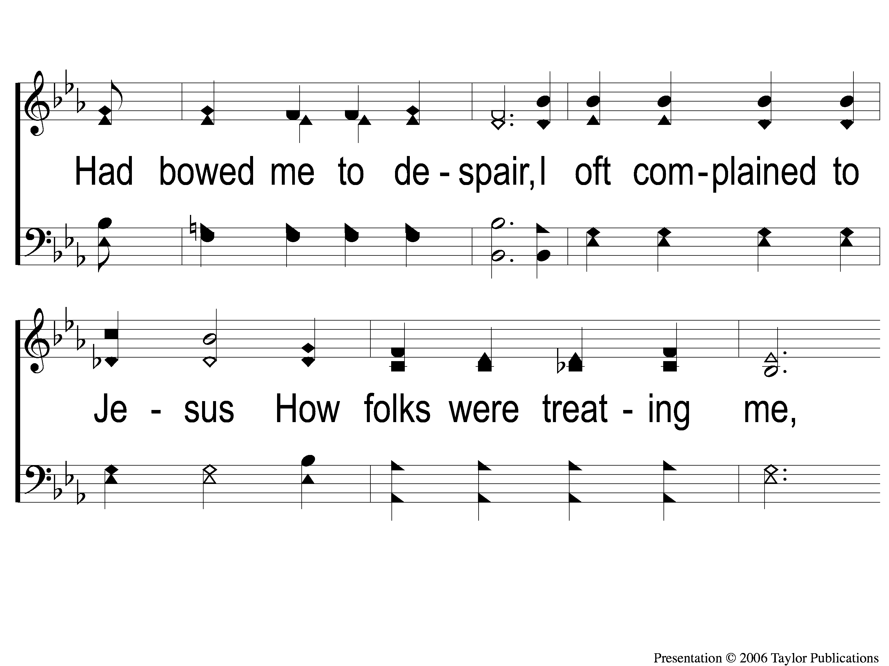
1-2 Follow Me
Follow Me
724
107

Slide 3
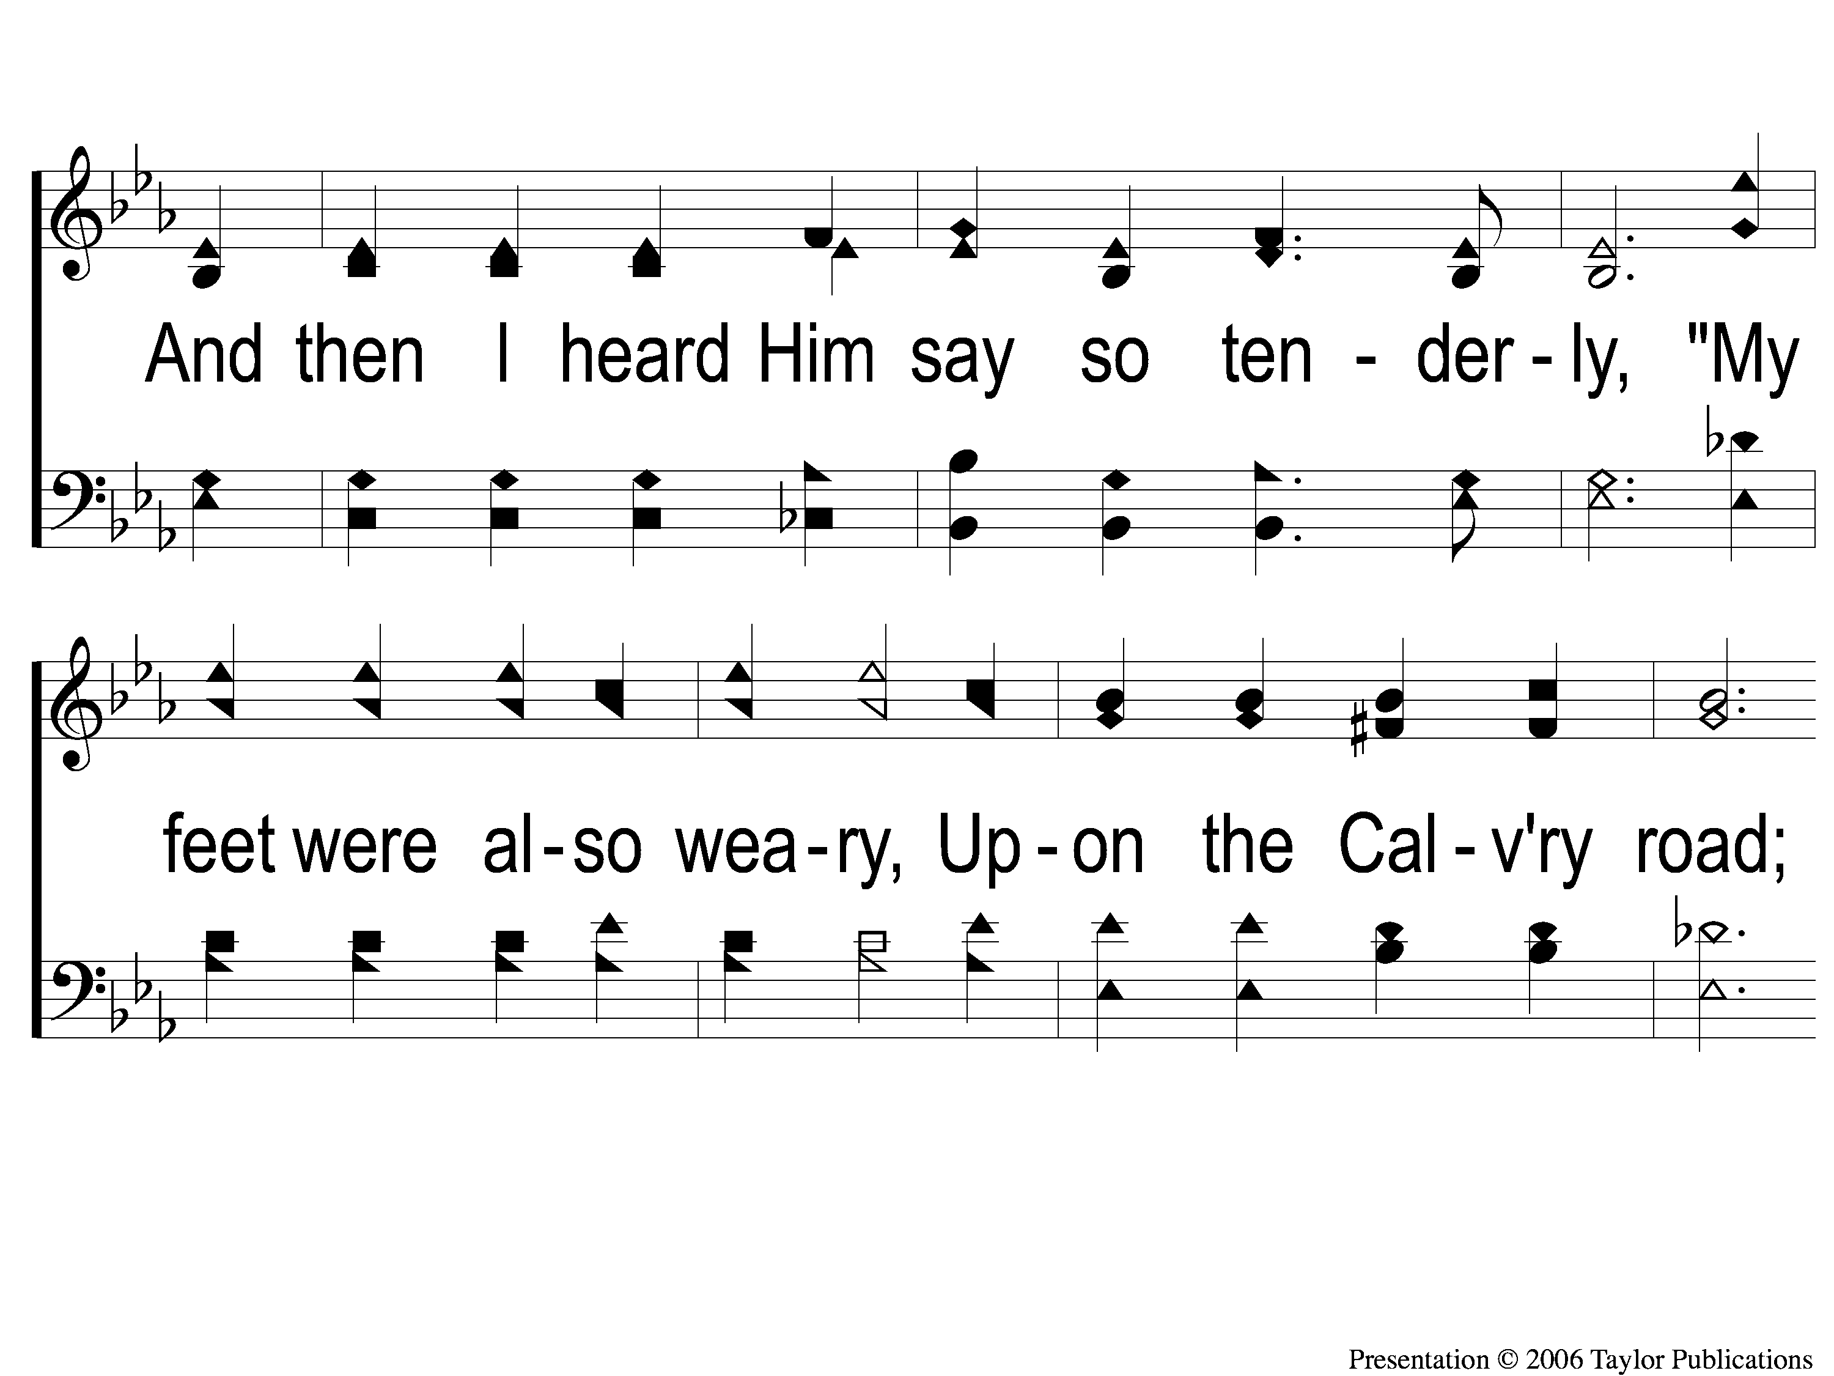
1-3 Follow Me
Follow Me
724
107

Slide 4
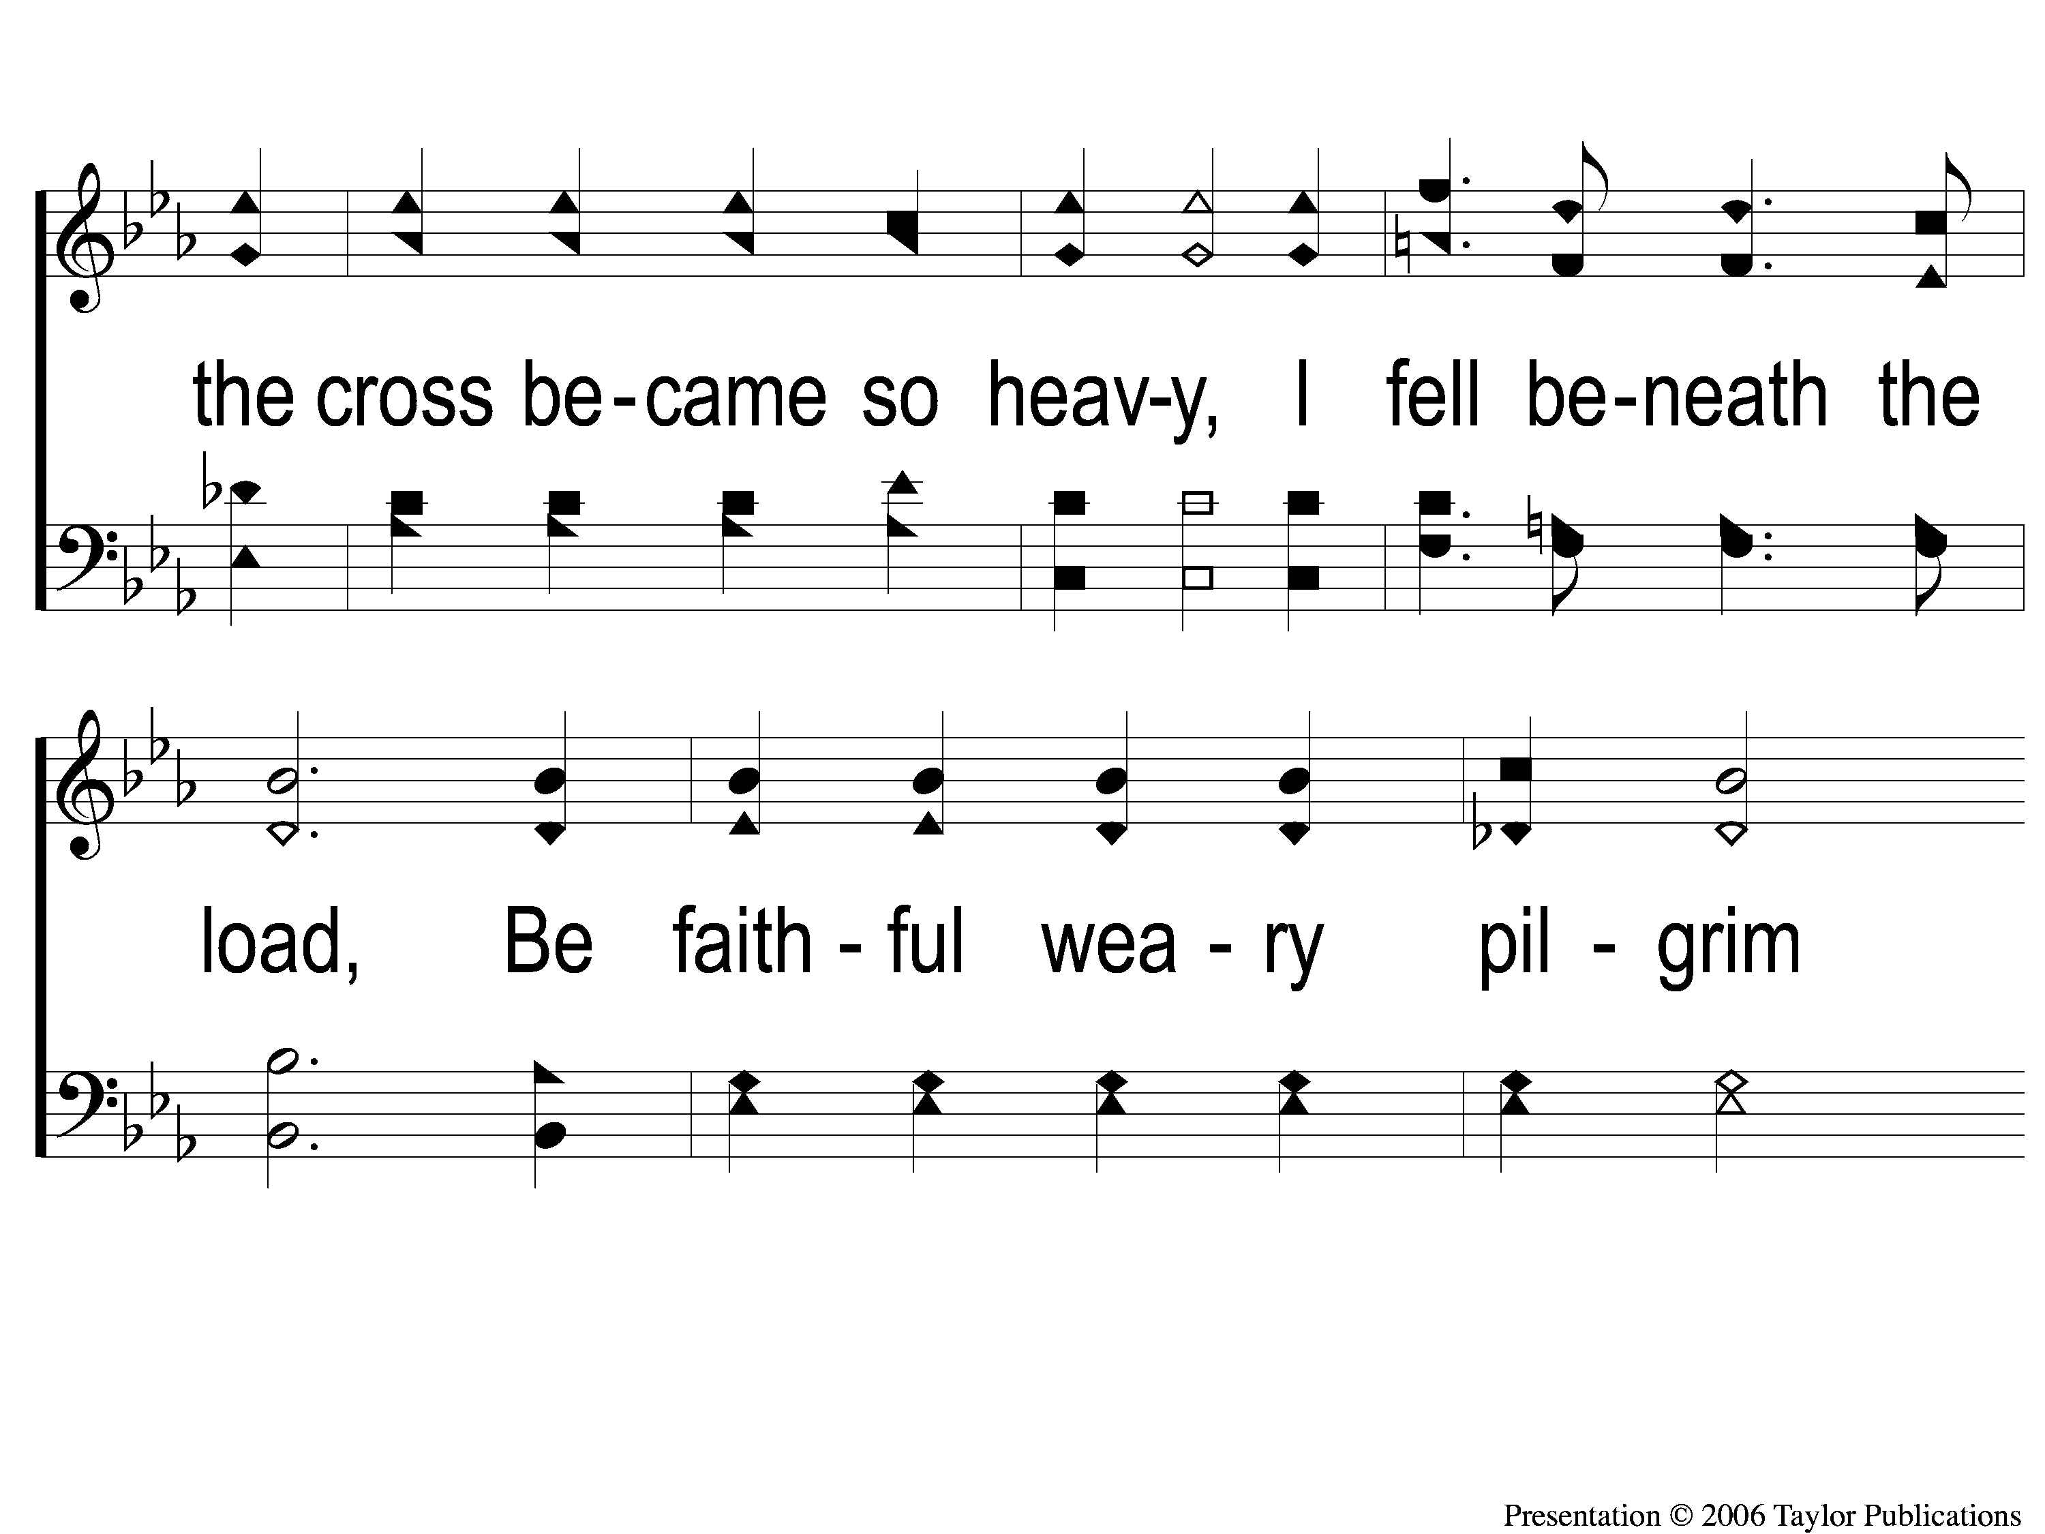
1-4 Follow Me
Follow Me
724
107

Slide 5
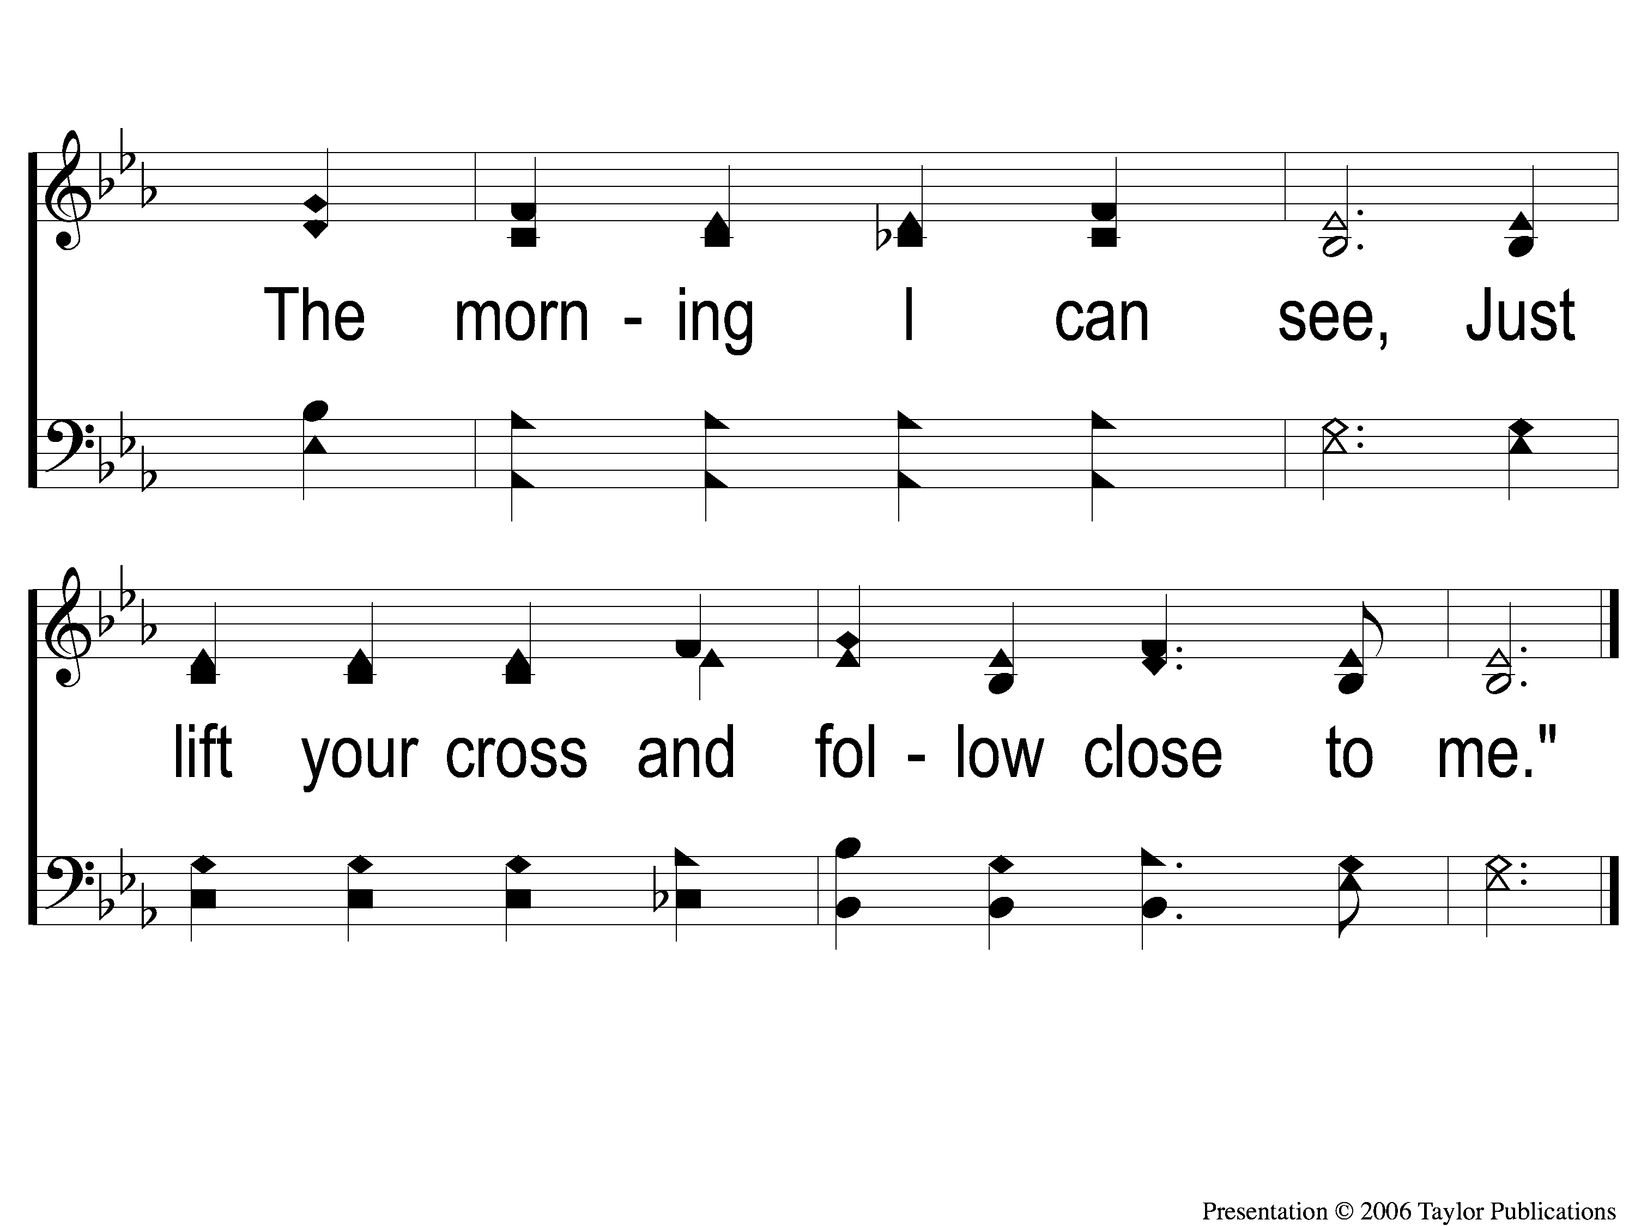
1-5 Follow Me
Follow Me
724
107

Slide 6
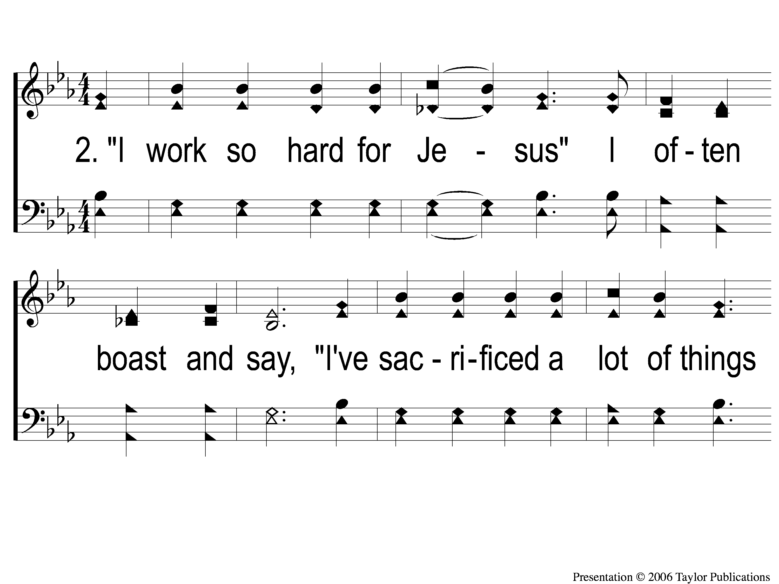
2-1 Follow Me
Follow Me
724
107

Slide 7
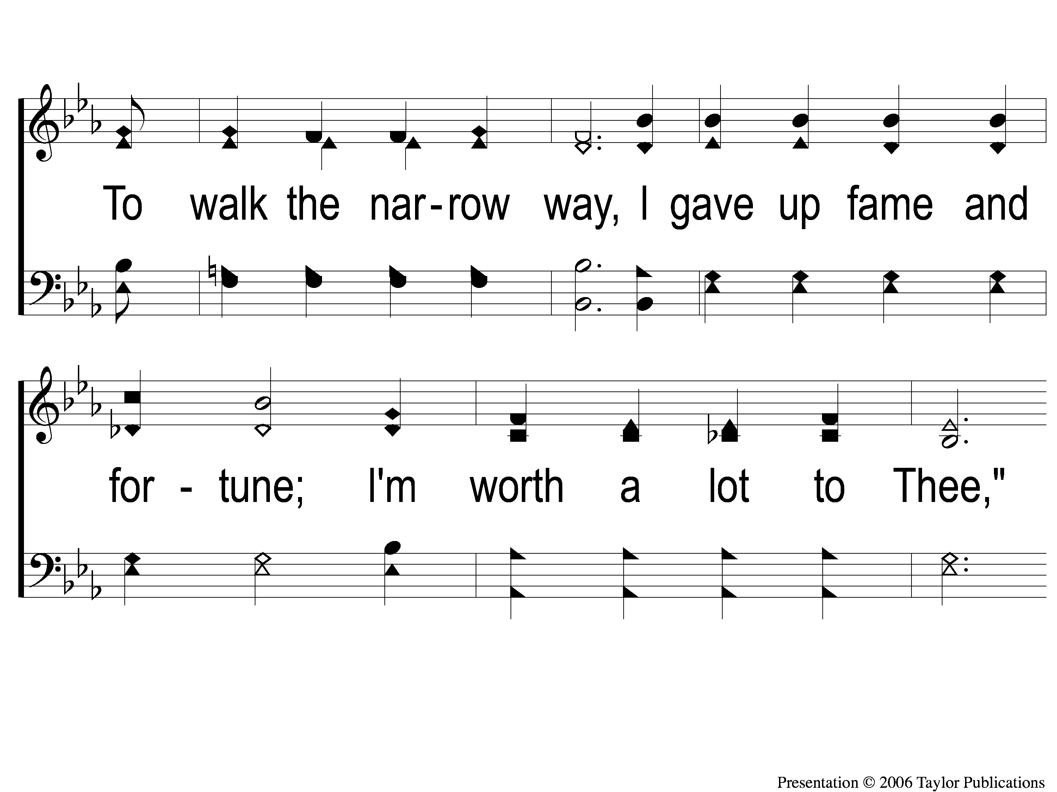
2-2 Follow Me
Follow Me
724
107

Slide 8
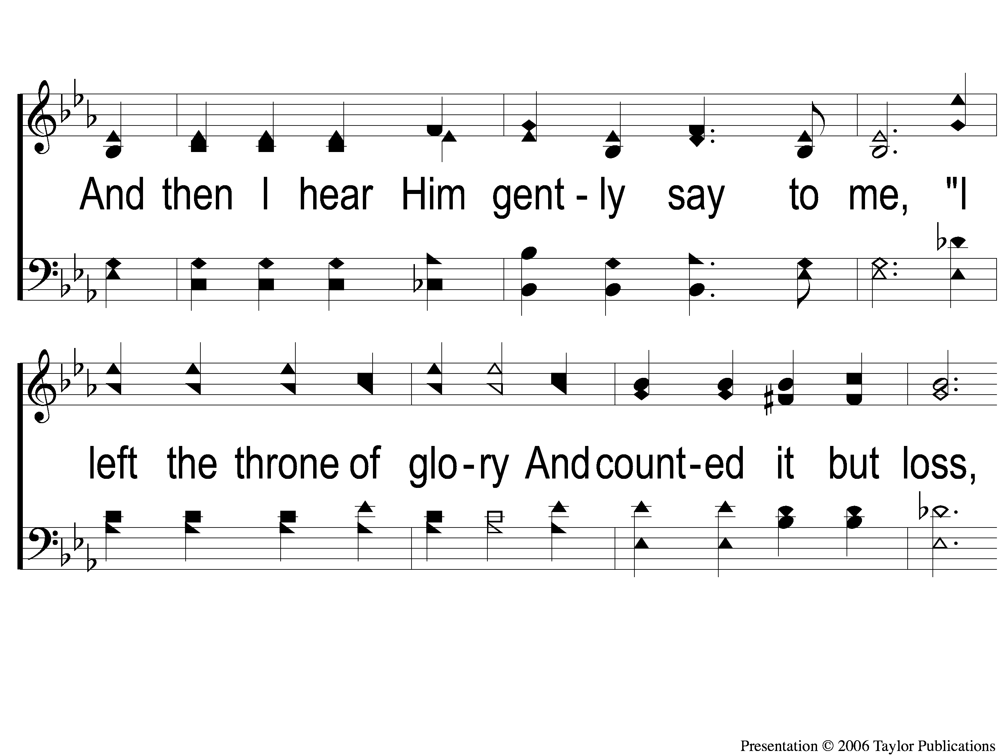
2-3 Follow Me
Follow Me
724
107

Slide 9
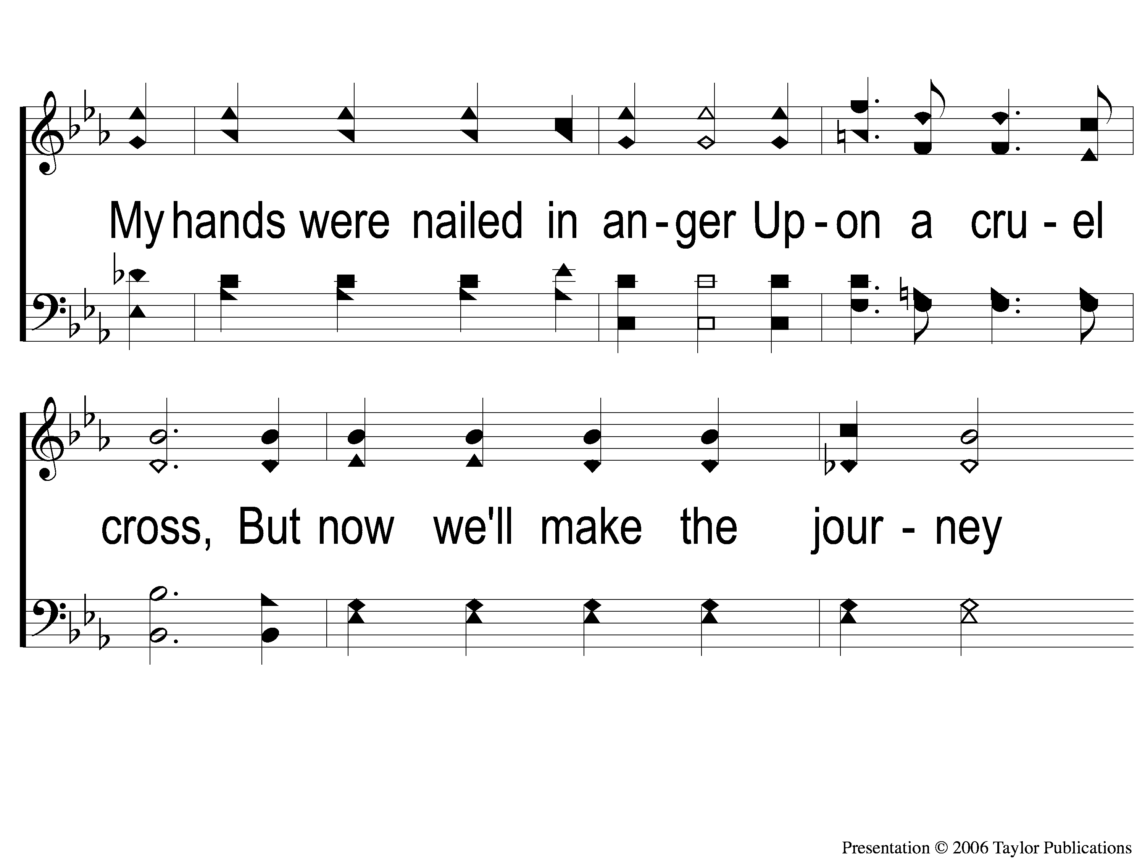
2-4 Follow Me
Follow Me
724
107

Slide 10
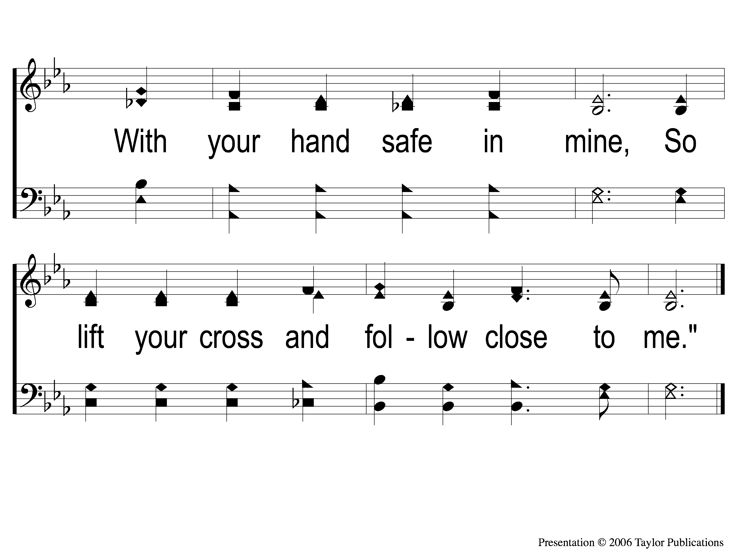
2-5 Follow Me
Follow Me
724
107

Slide 11
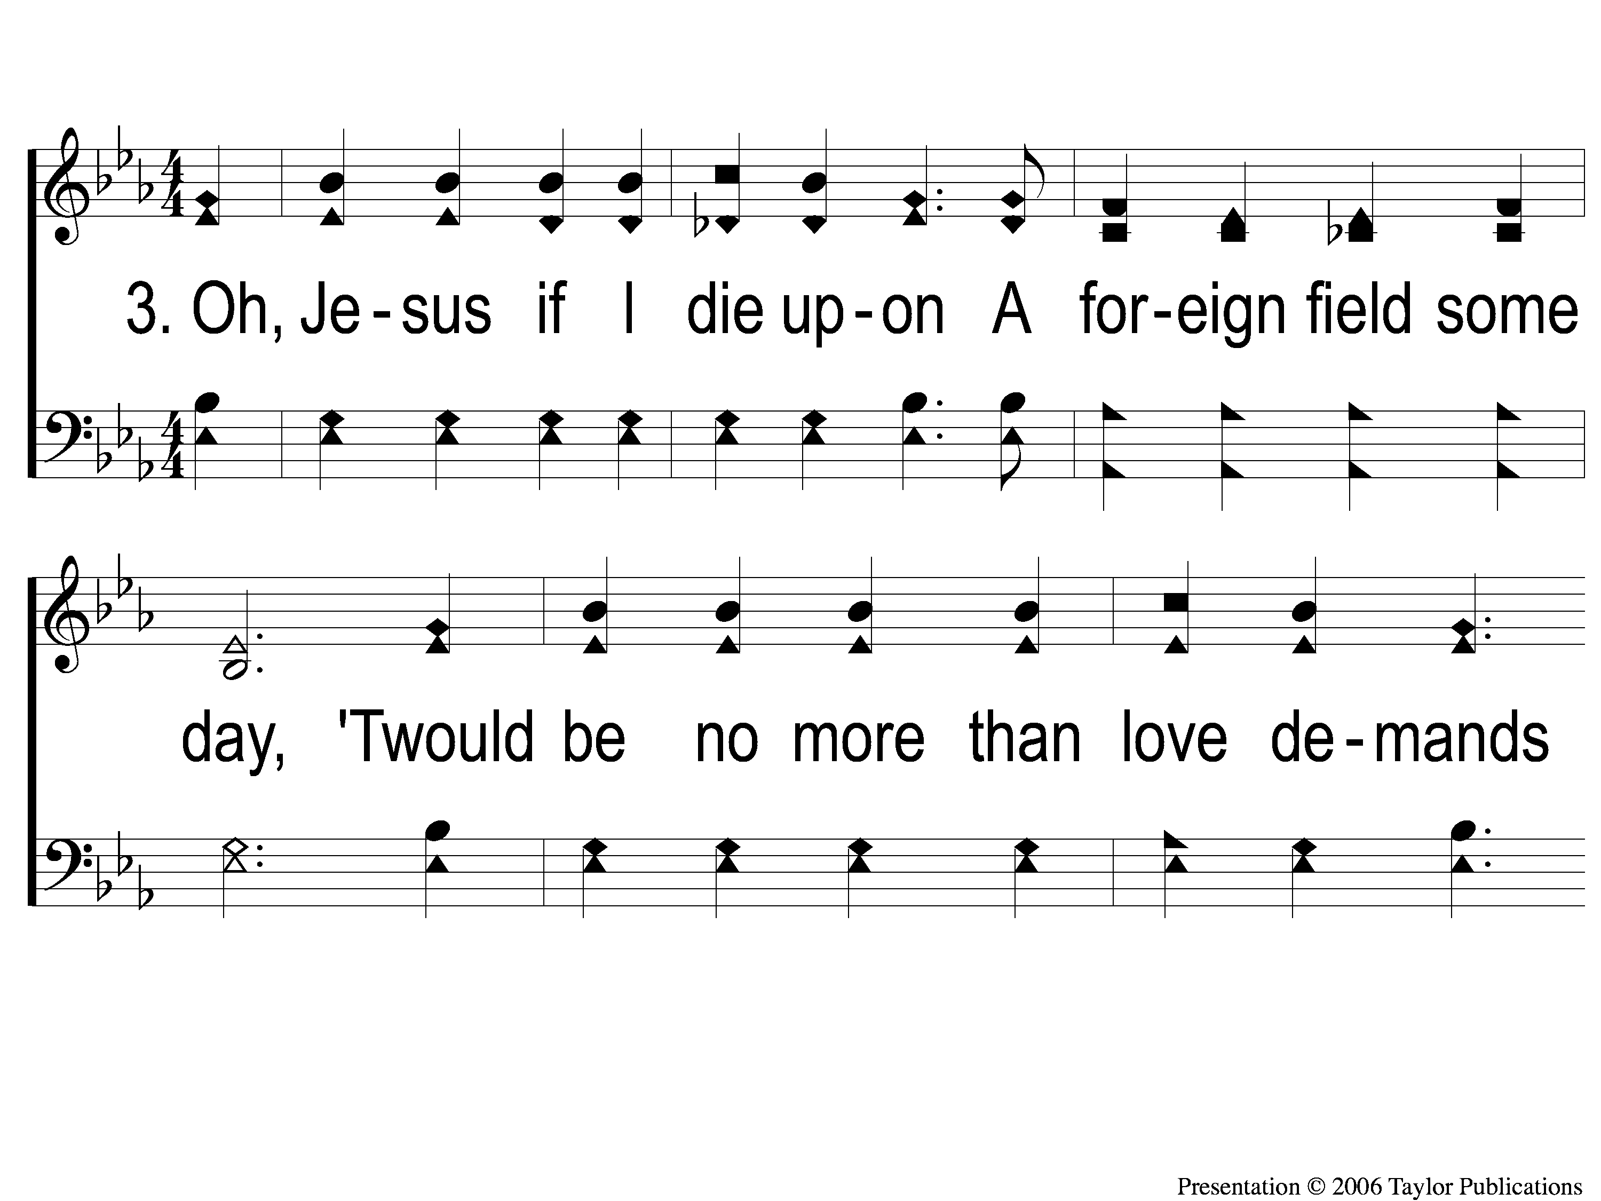
3-1 Follow Me
Follow Me
724
107

Slide 12
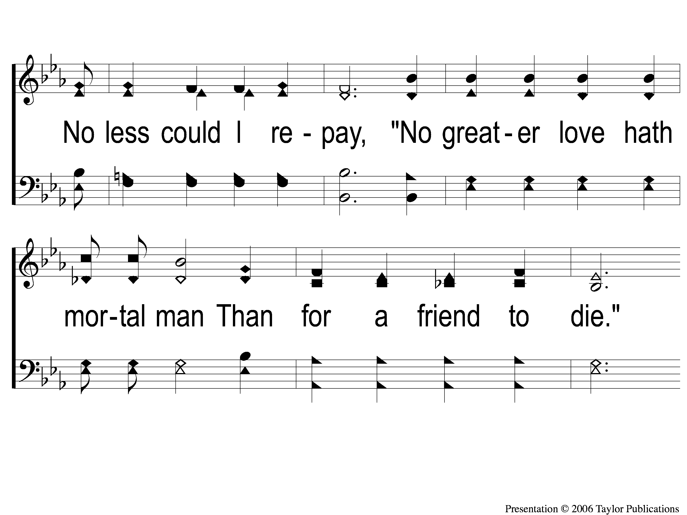
3-2 Follow Me
Follow Me
724
107

Slide 13
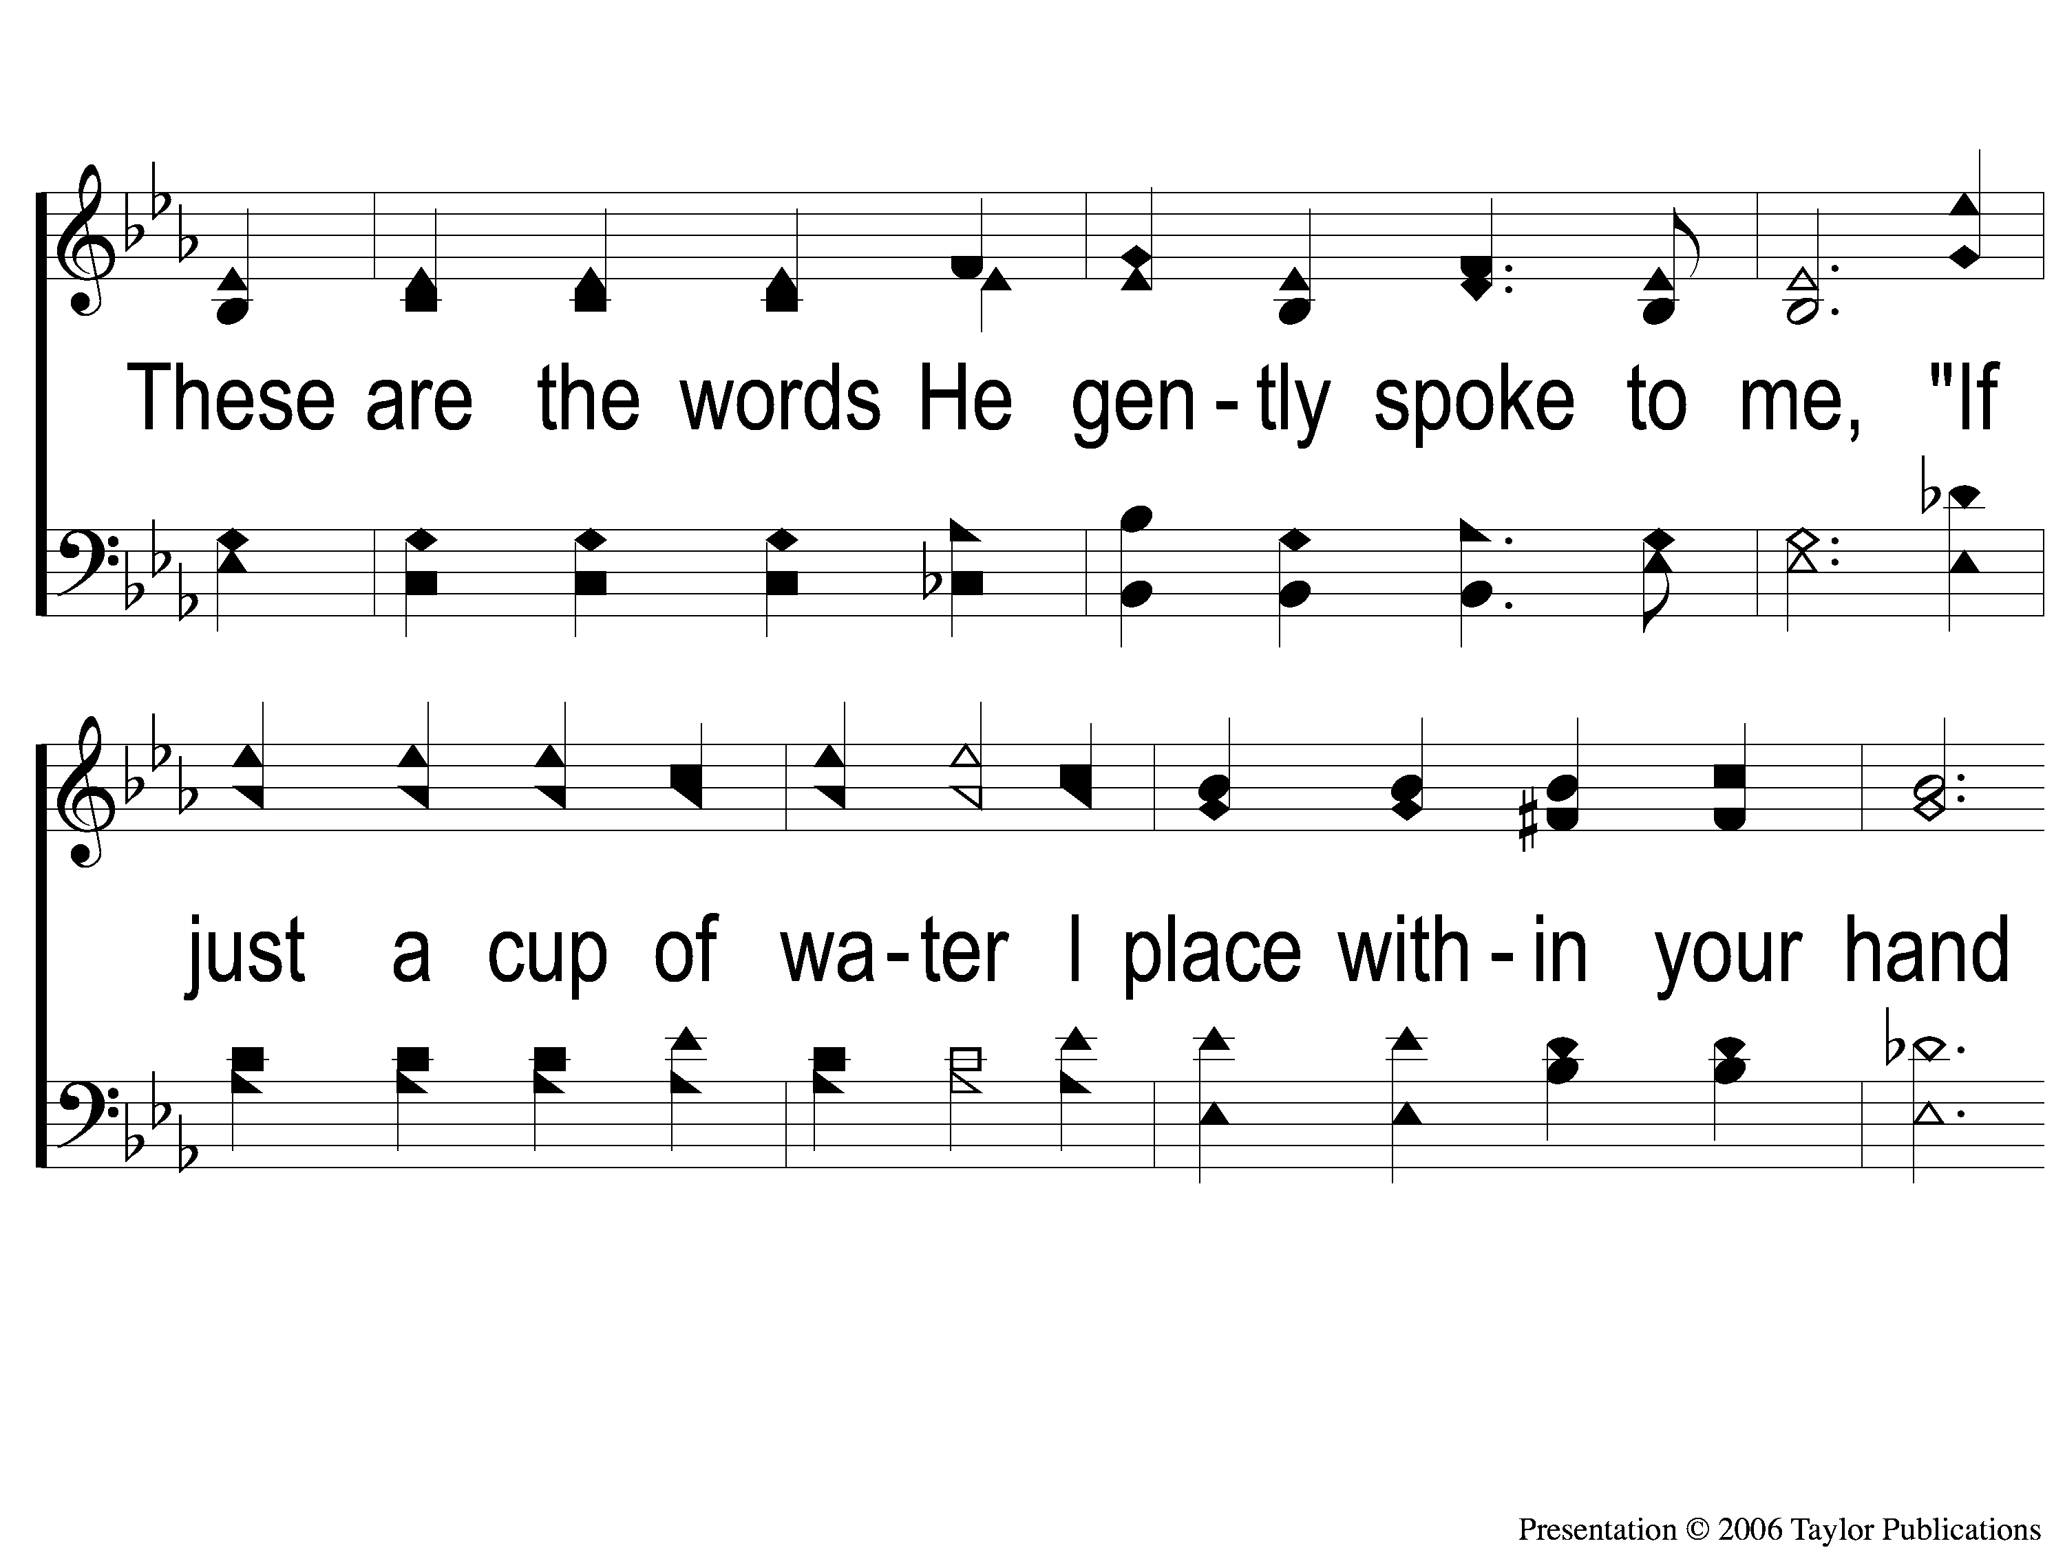
3-3 Follow Me
Follow Me
724
107

Slide 14
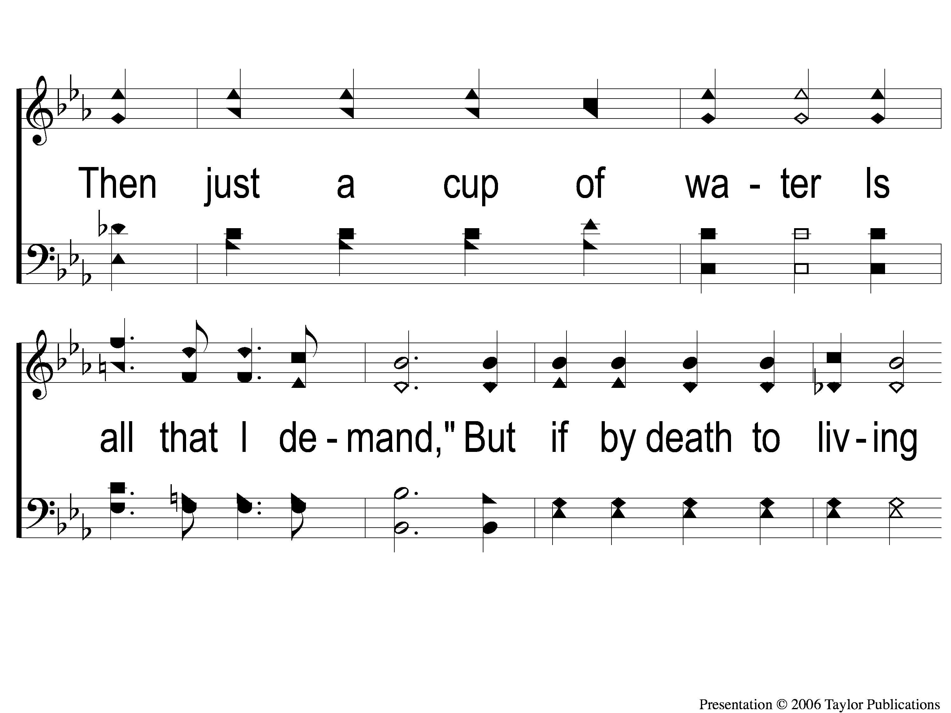
3-4 Follow Me
Follow Me
724
107

Slide 15
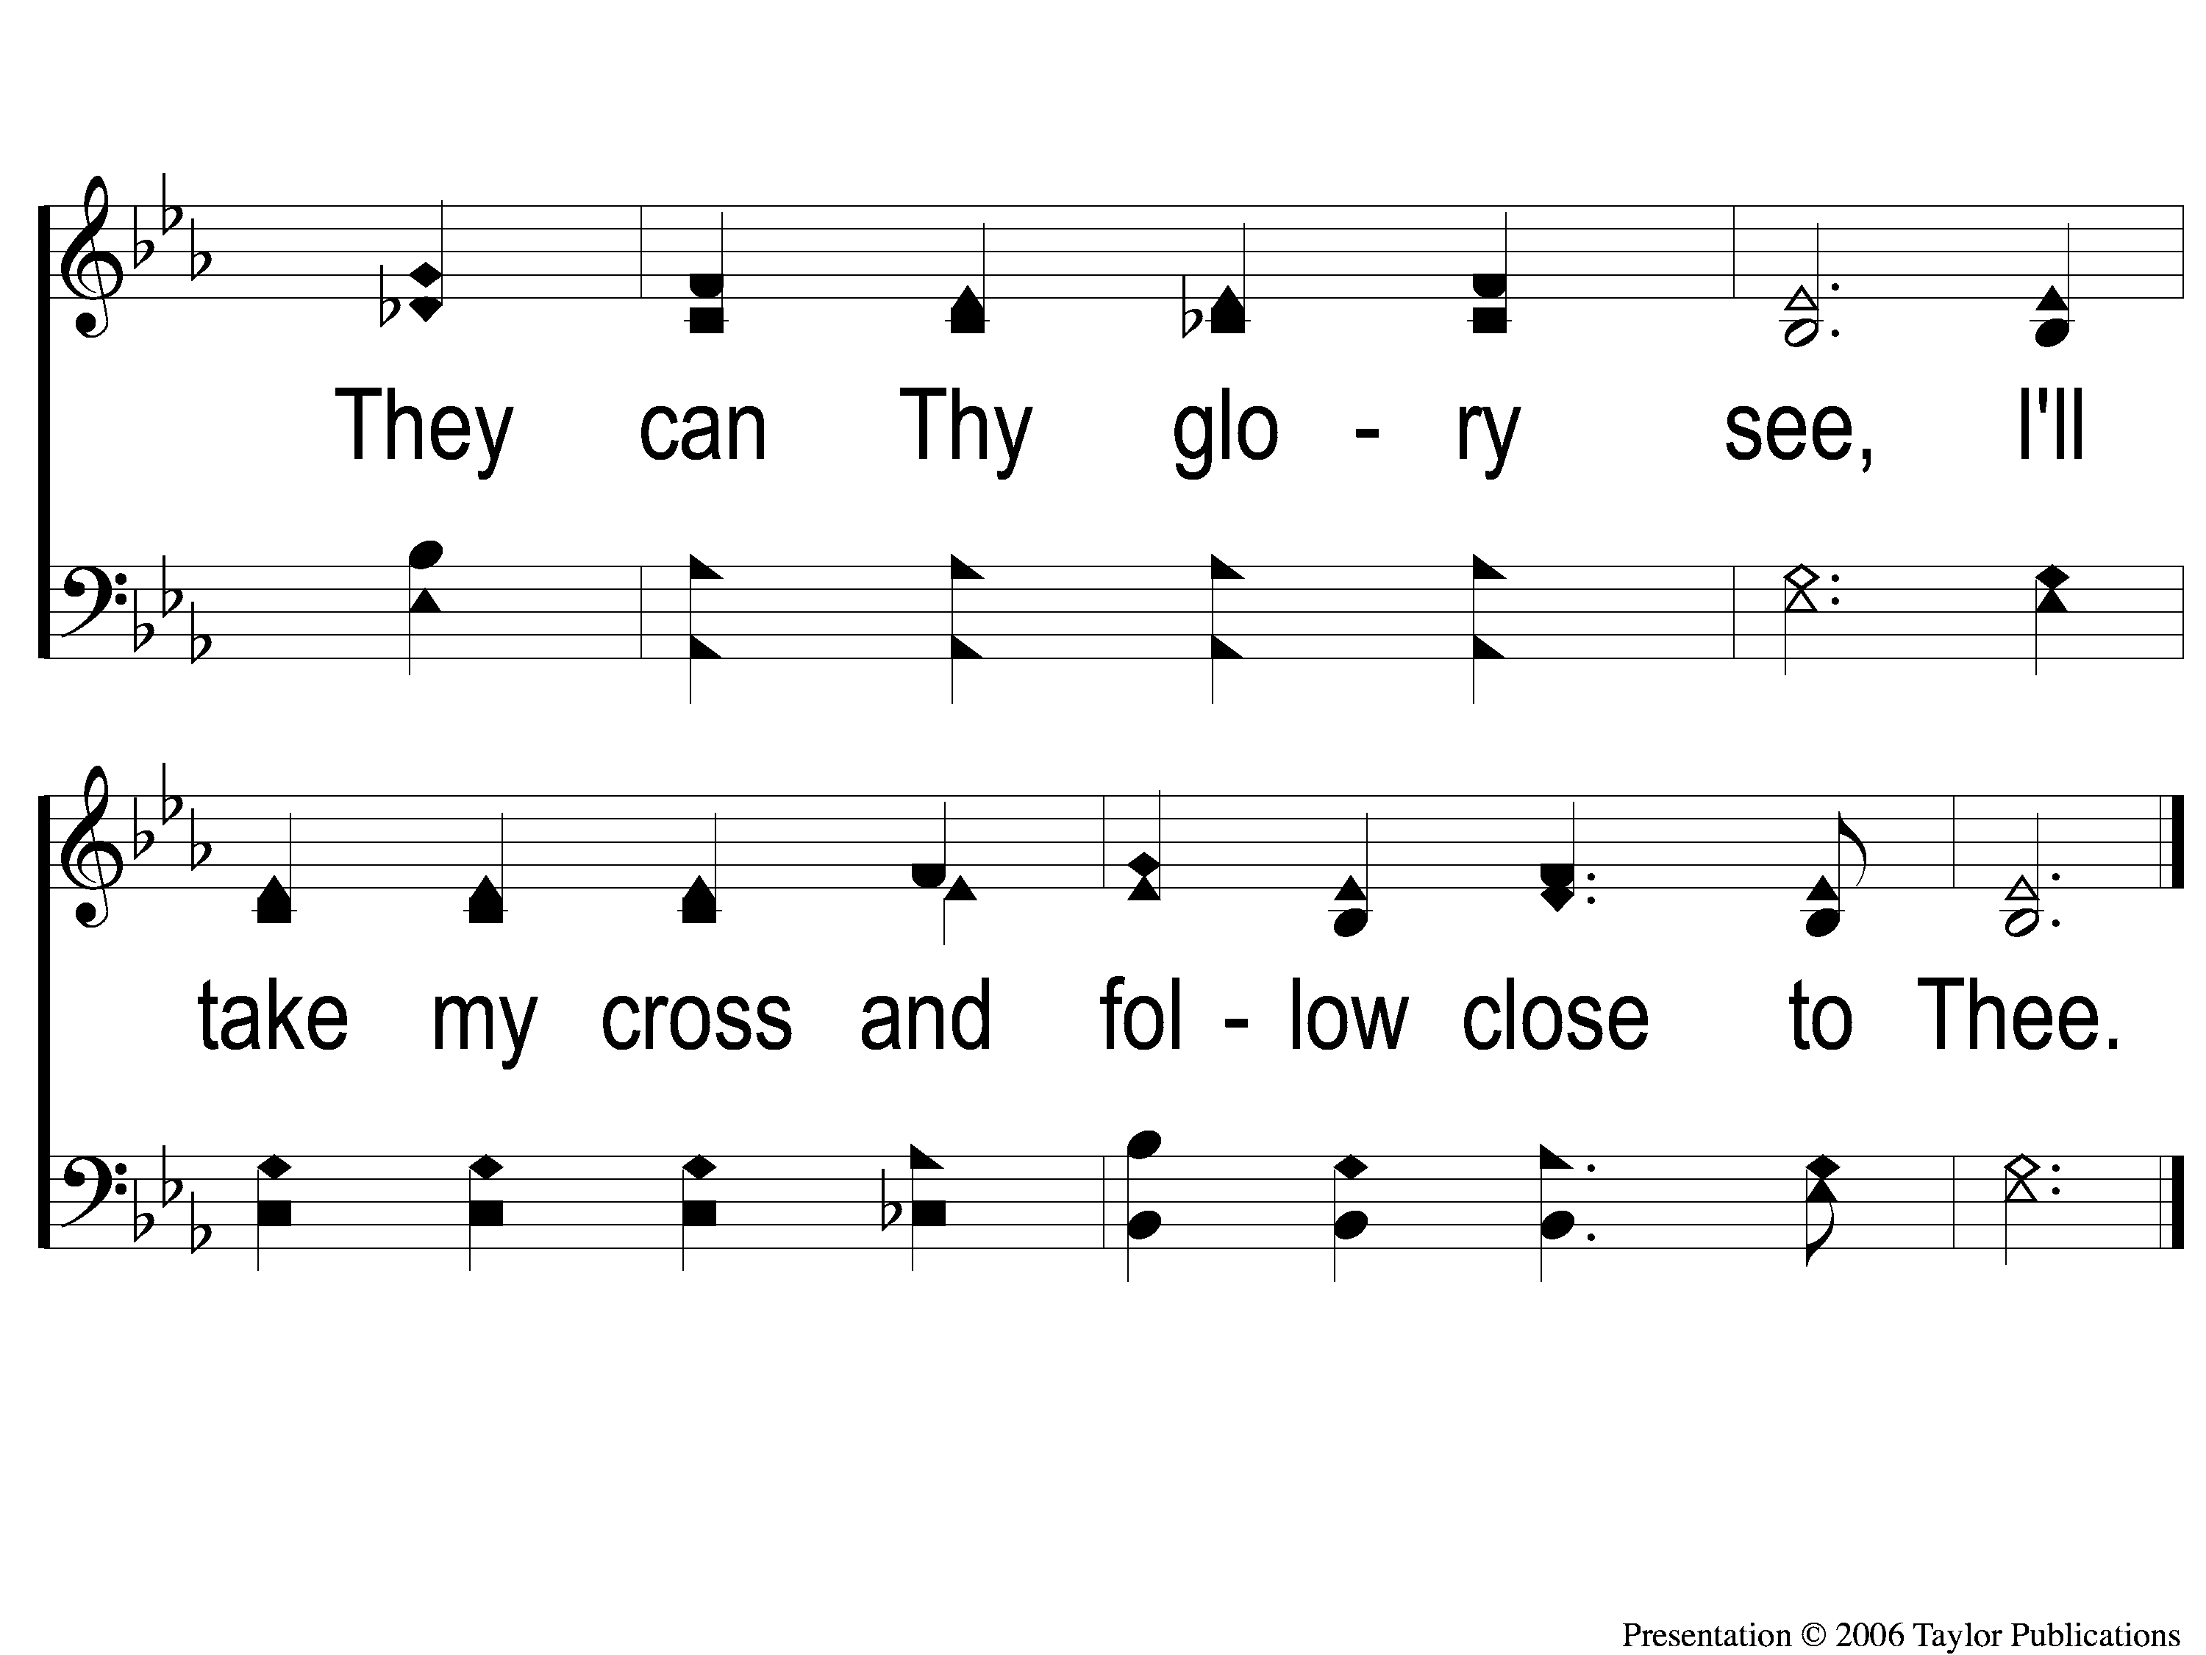
3-5 Follow Me
Follow Me
724
107

